Slide 1
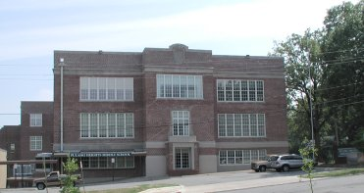
Pulaski Heights Middle School 2018-2019 School Improvement Plan
Darryl J. Powell
Principal

Slide 2
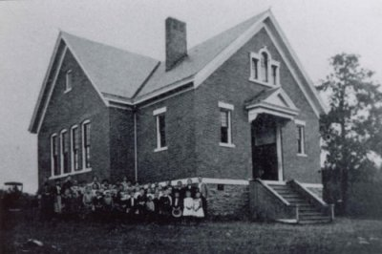
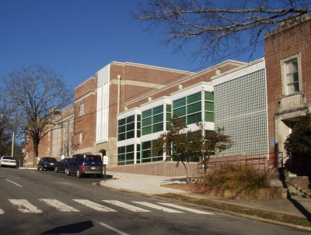
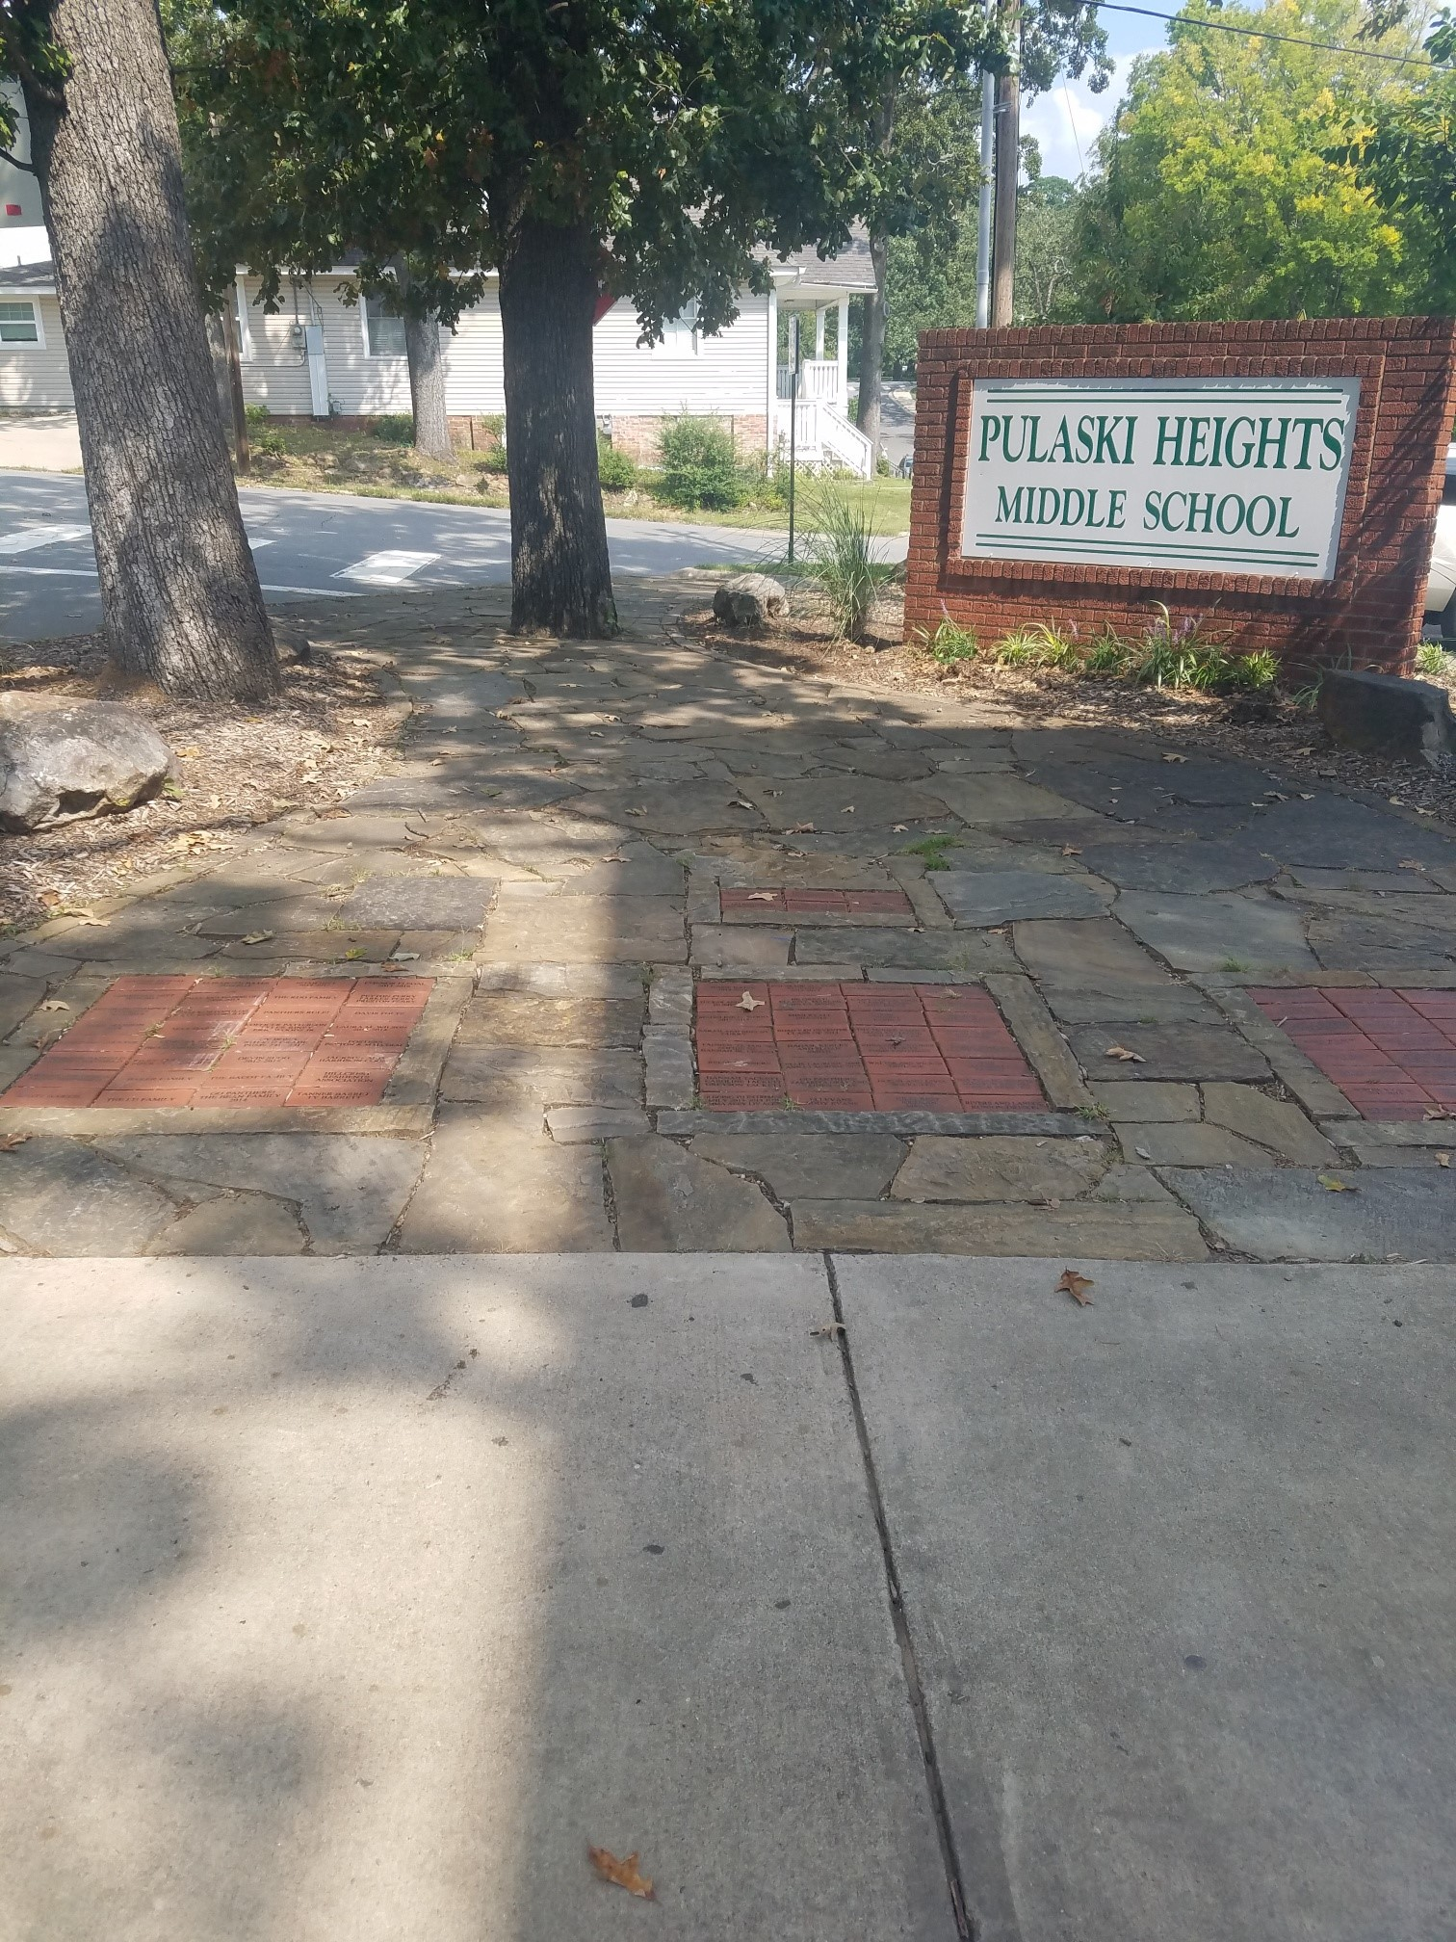
Our History
At 110 years old, PHMS is one of the oldest and most respected schools in the LRSD.
Pulaski Heights Middle School is consistently among the highest performing middle schools in the LRSD and Pulaski County.
Pulaski Heights Middle School attracts and retains a skilled, creative, and dedicated teaching staff.
The student population at PHMS remains one of the most diverse populations in the LRSD.
.

Slide 3
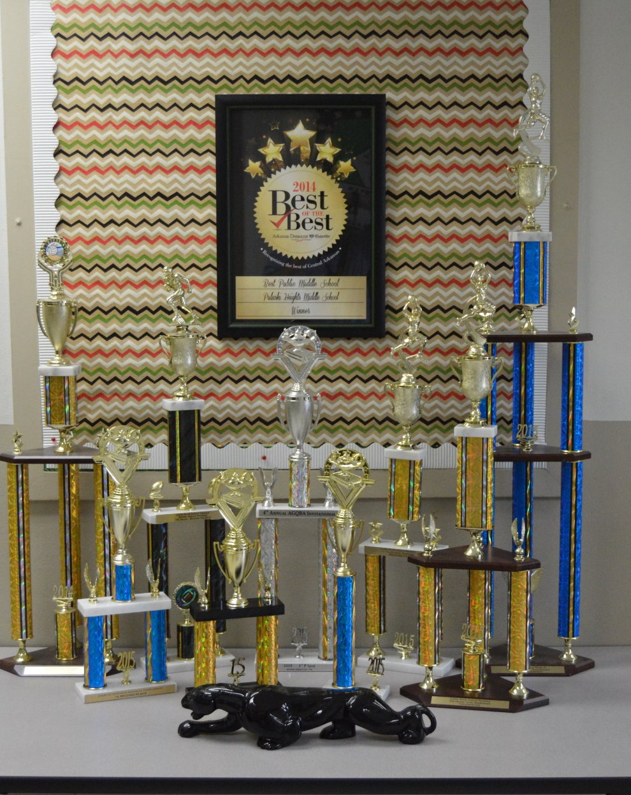
Continuing a Tradition of EXCELLENCE
PHMS teachers consistently participate in professional development opportunities to learn and perfect new and innovated instructional strategies.
Each year new classes are added to the PHMS list of course offerings – Accelerated Physical Science, GT English, GT Math, GT Science, Design & Modeling, and Imagination Zone
PHMS is in pursuit of STEAM recognition - we facilitate higher-level courses in Science, Technology, Engineering, Arts, and Mathematics.

Slide 4
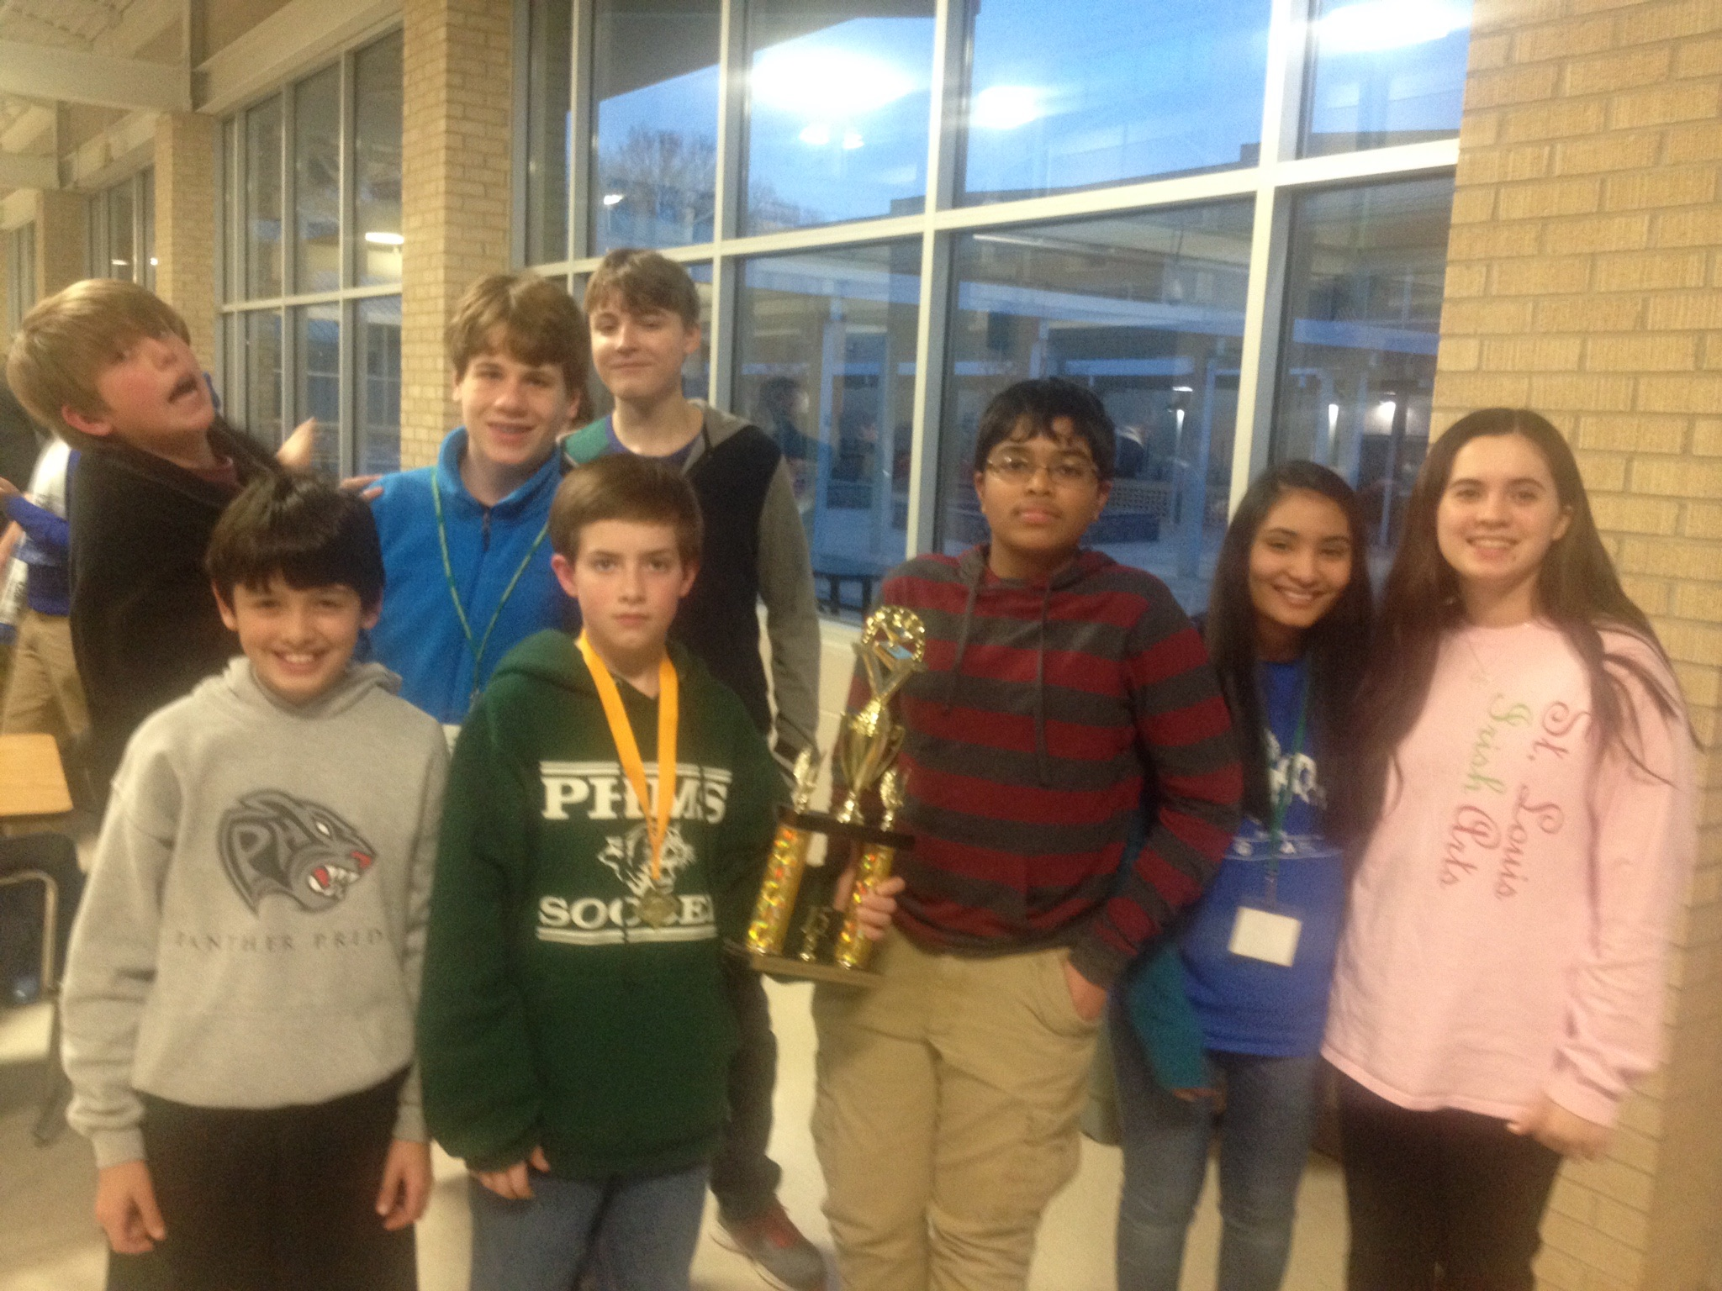
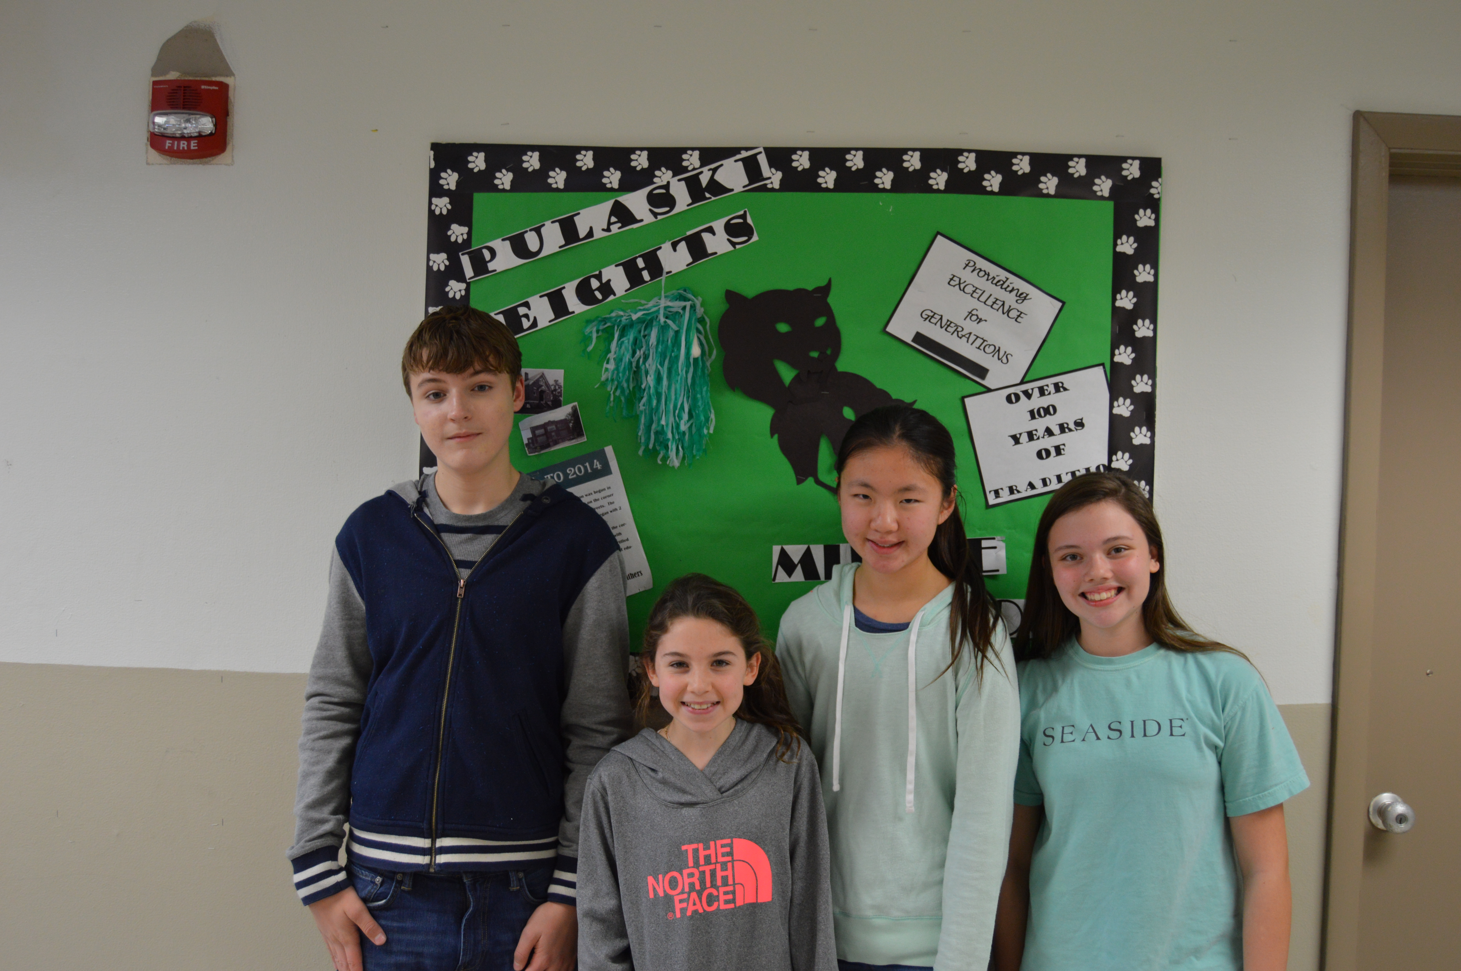
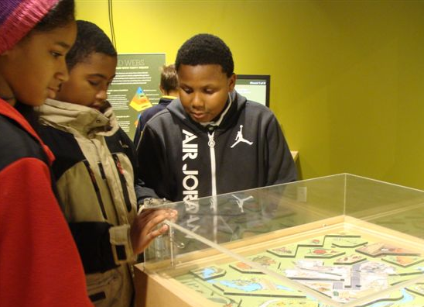
Focus Area 1: Leadership Goal: Implement and maintain a professional learning community characterized by shared decision making and continuous improvement.
Shared leadership philosophy
Internal Leadership Team
Monitors instructional efforts
Reviews data
Achieving Leadership Team
Monitors instructional efforts
Monitors school performance
Reviews data
Implementation is monitored by agendas, instructional collaborations, data reporting, and deliberate evaluations.

Slide 5
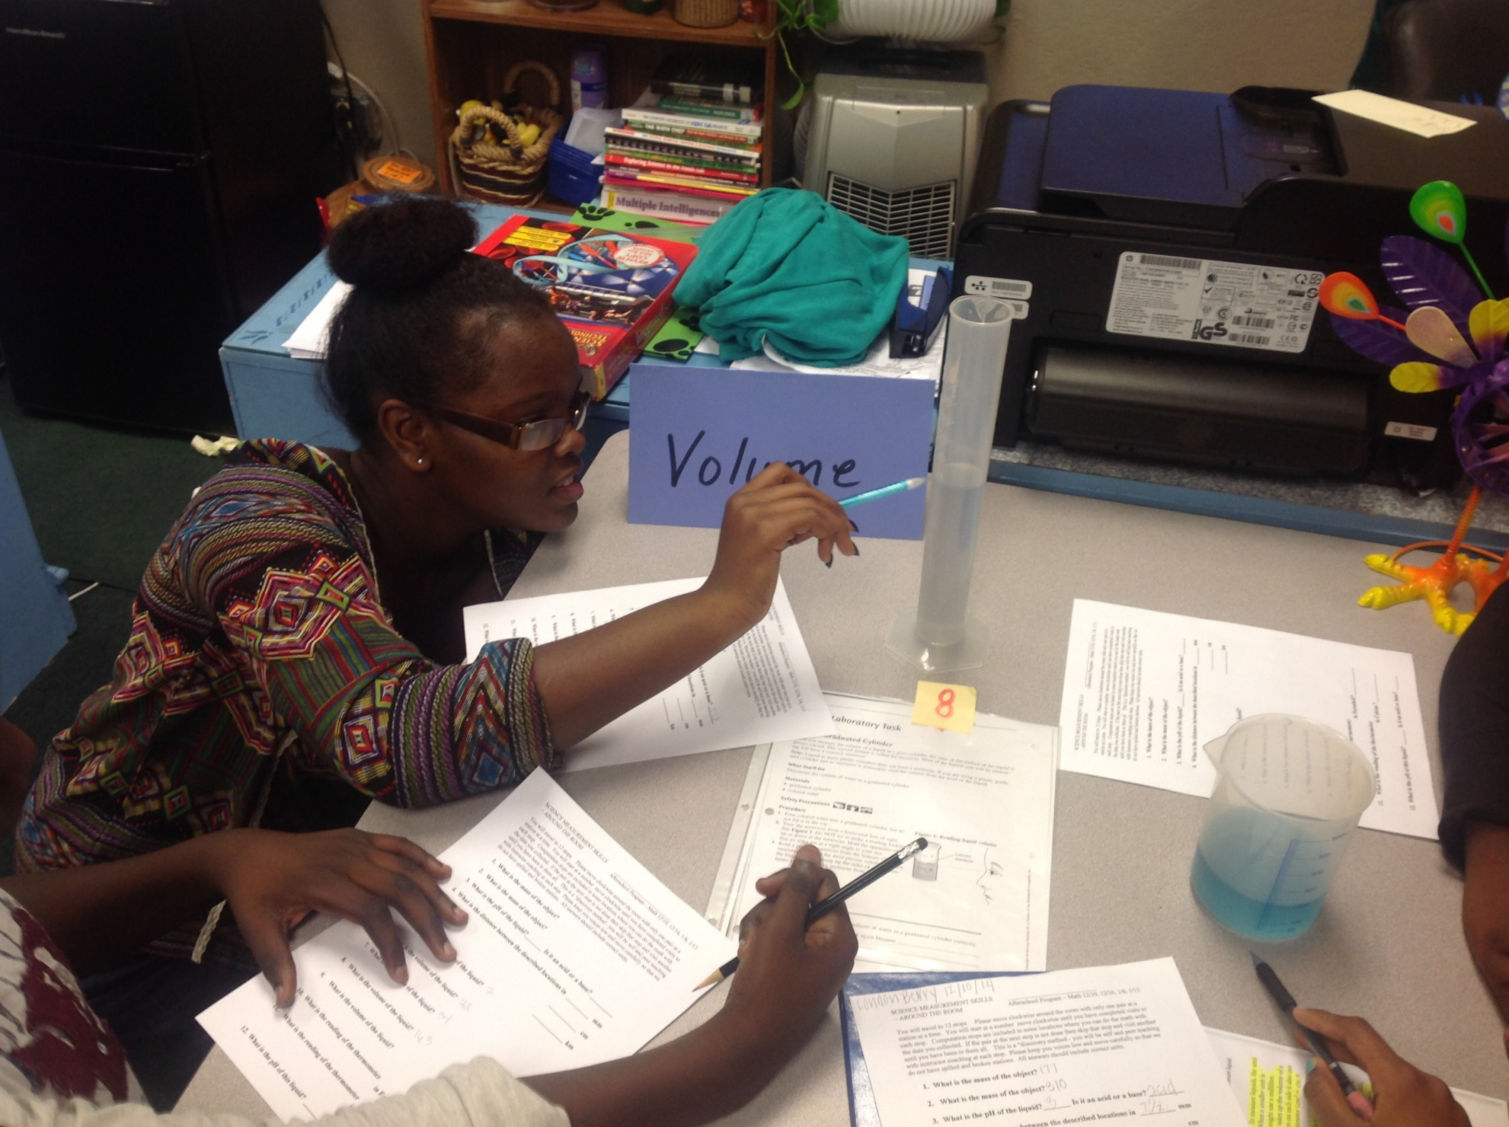
Focus Area 2: Effective Instructional Practices Goal: Improve instructional practices that support student achievement
Instructional Team Structure
Grade level collaborations and PLCs
DOK Implementation and ACT Aspire tested skills
Read 180 and Math 180
School Wide Reading Initiative
Partnership with UALR for tutoring
GT courses
Disciplinary literacy
Reading comprehension skills focus in traditional classes
Project Based Learning
Implementation is monitored through classroom observations, collaborations, lesson plan reviews, data analysis, and student feedback.

Slide 6
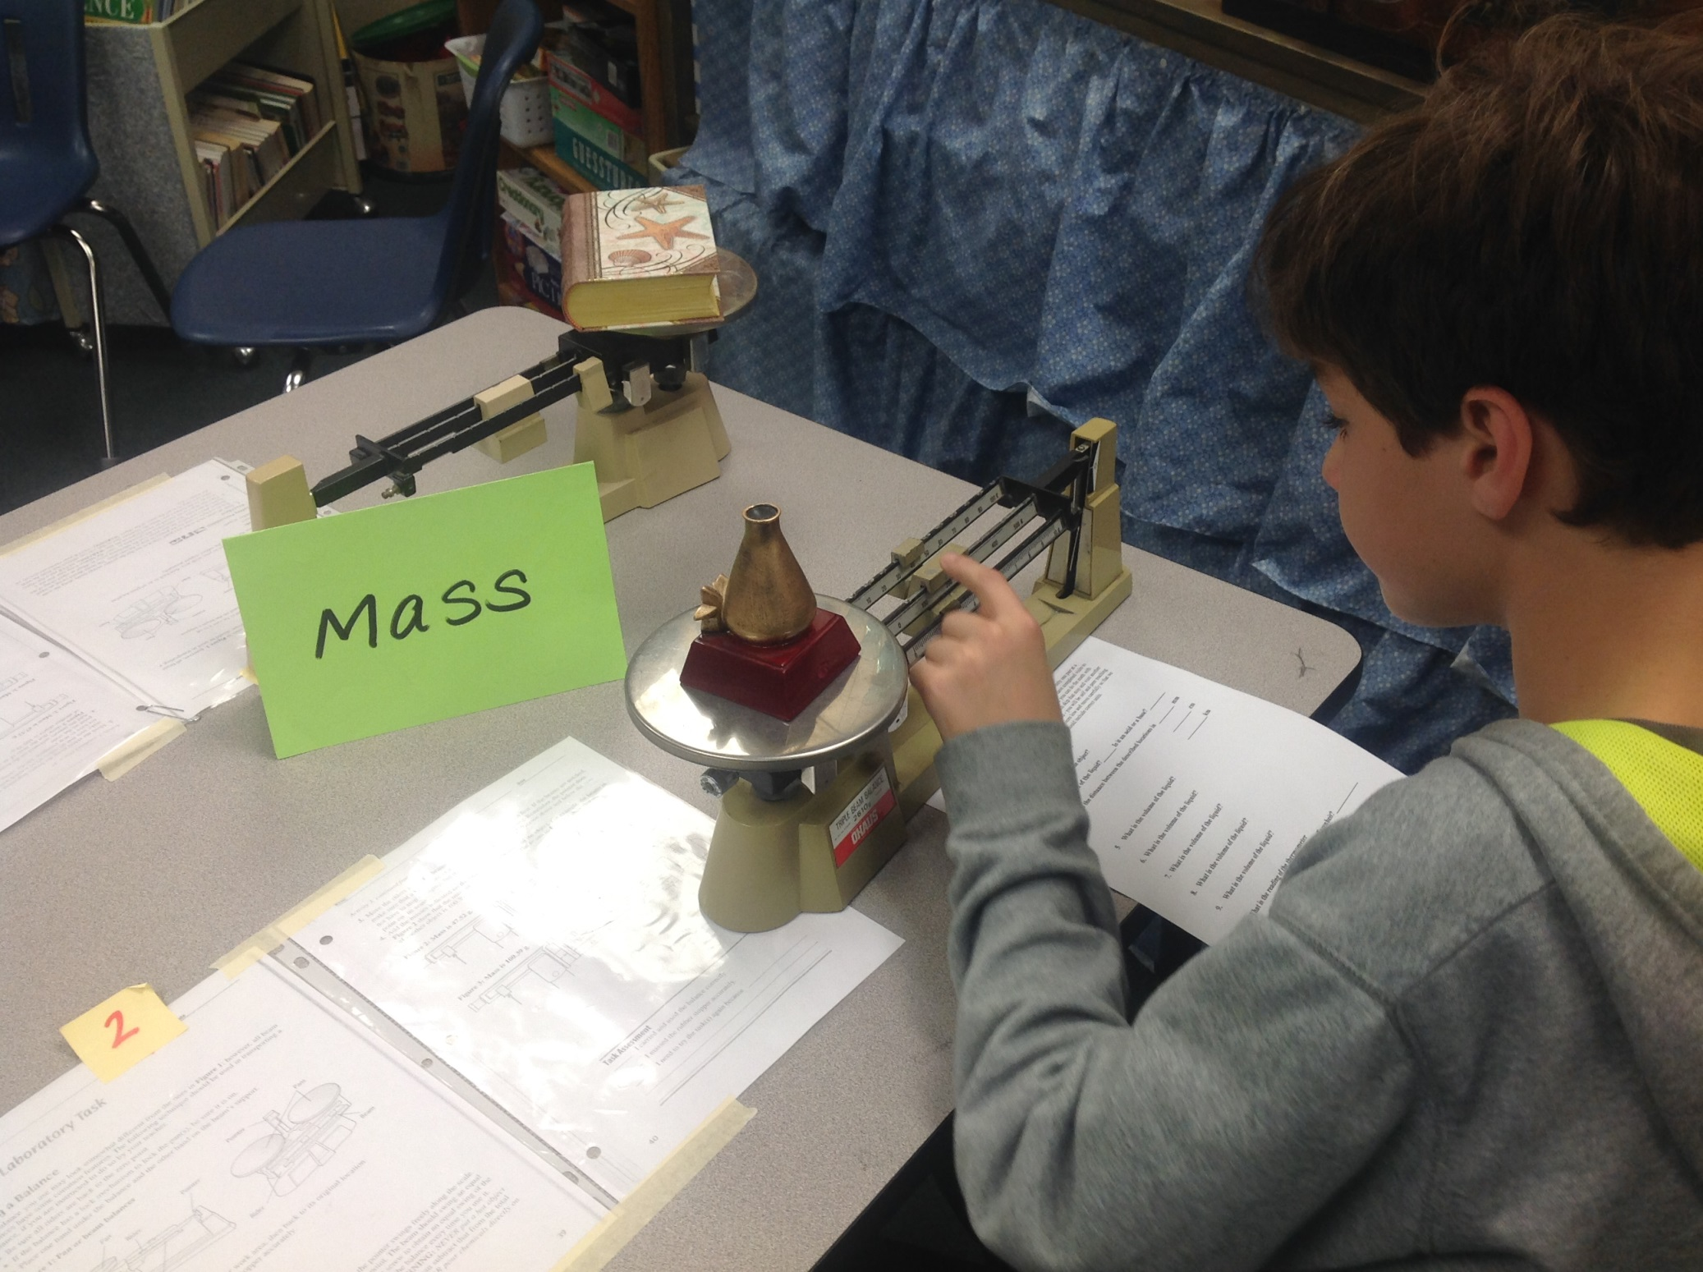
Focus Area 3: Student Growth and Achievement Goal: Improve core instructional practices that support student achievement and growth.
Use data for correct student placements, interventions, and additional support to remain on track to meet academic goals.
Accelerated Math, GT, Pre-AP, Traditional, Inclusion, Resource, Math 180 and Read 180
High school credit courses: Algebra 1, French, Spanish, and Accelerated Physical Science
Achievement goals for Literacy, Math, and Science:
Decrease In Need of Support by 3% annually
Increase the number of Ready and Exceeding by 3% annually
At least 50% of population will score at the 50th percentile
Implementation is monitored by classroom observations, CFAs, Math and Reading inventories, STAR, NWEA interims, and ACT Aspire summative assessment.

Slide 7
Focus Area 4: School Culture and Discipline Goal: to create and maintain a school culture that fosters students achievement and positive behavior
School Culture
Teachers
Transfer rates are low
Feel supported by administration and treated professionally
Feel it is a good place to work
Students
Feel safe
Understand expectations and are treated fairly
Parents
Feel children are safe
PHMS is a top choice for families
PTSA is active
Implementation is monitored by parent involvement participation, students disciplinary dynamics, and overall teacher morale.

Slide 8
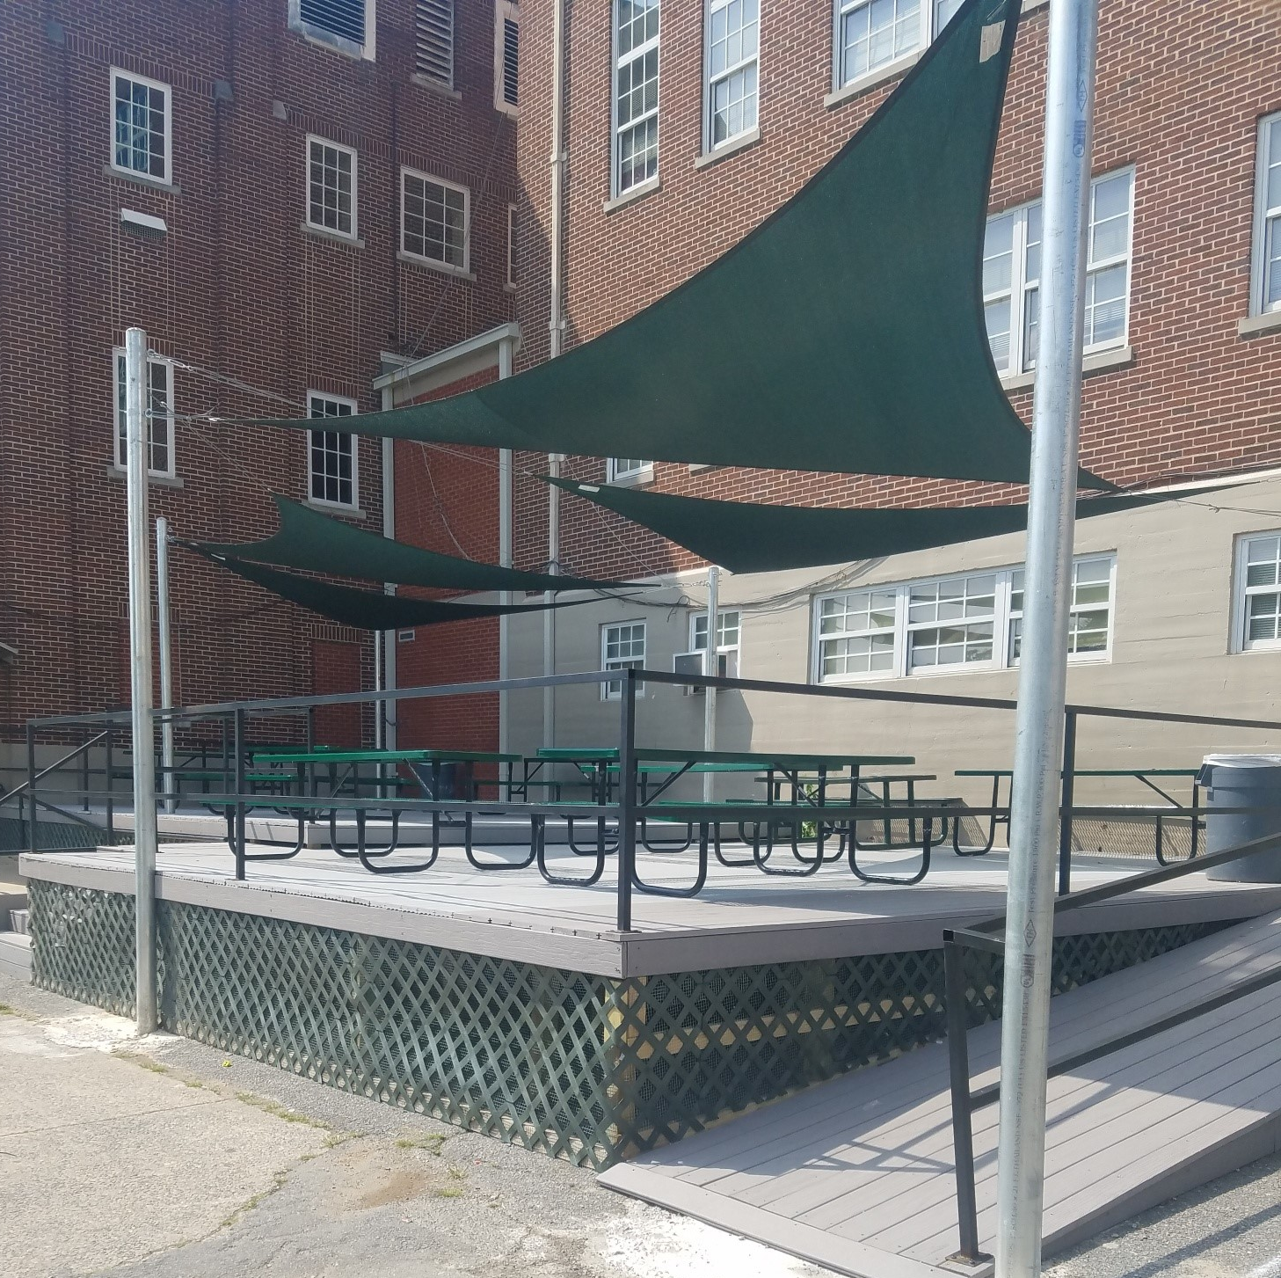
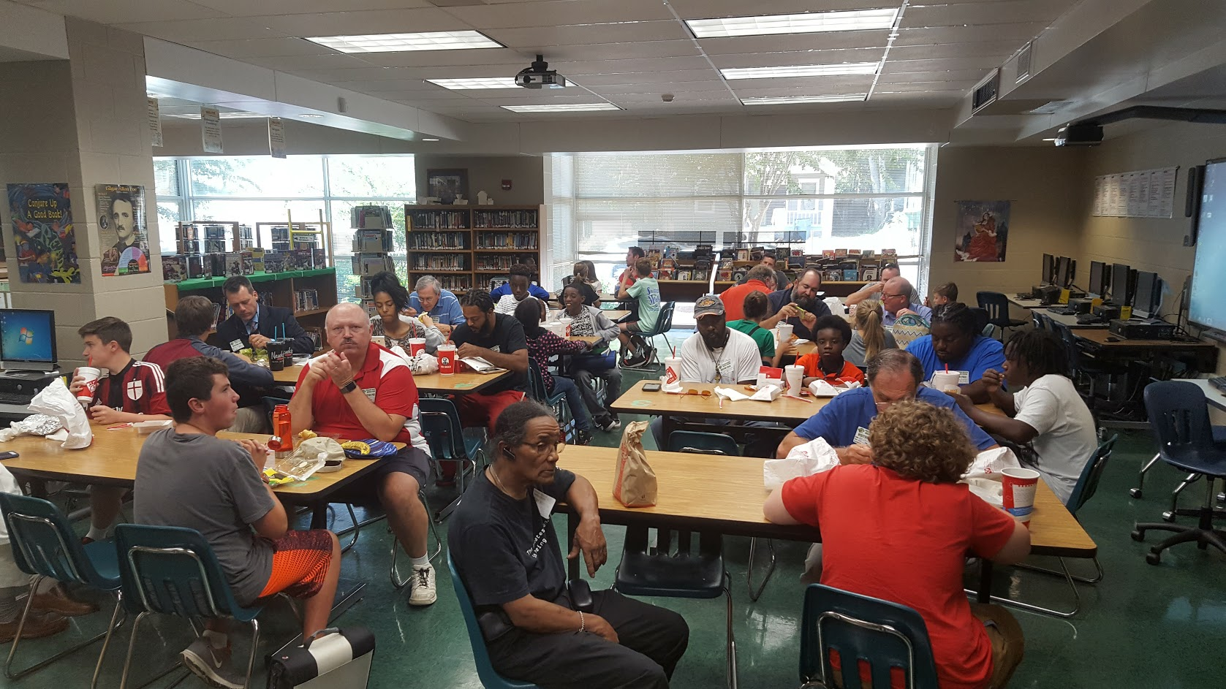
Focus Area 5: Parent Engagement Goal: Improve adult practices that support student achievement and growth.
Parents are partners
Parent Involvement Plan
Customer Service
PTSA collaborations
Teachers lounge
Desktop computers
Deck
Grounds
School Wide Reading Initiative
Implementation is monitored by the parent facilitator and other PHMS stakeholders.

Slide 9
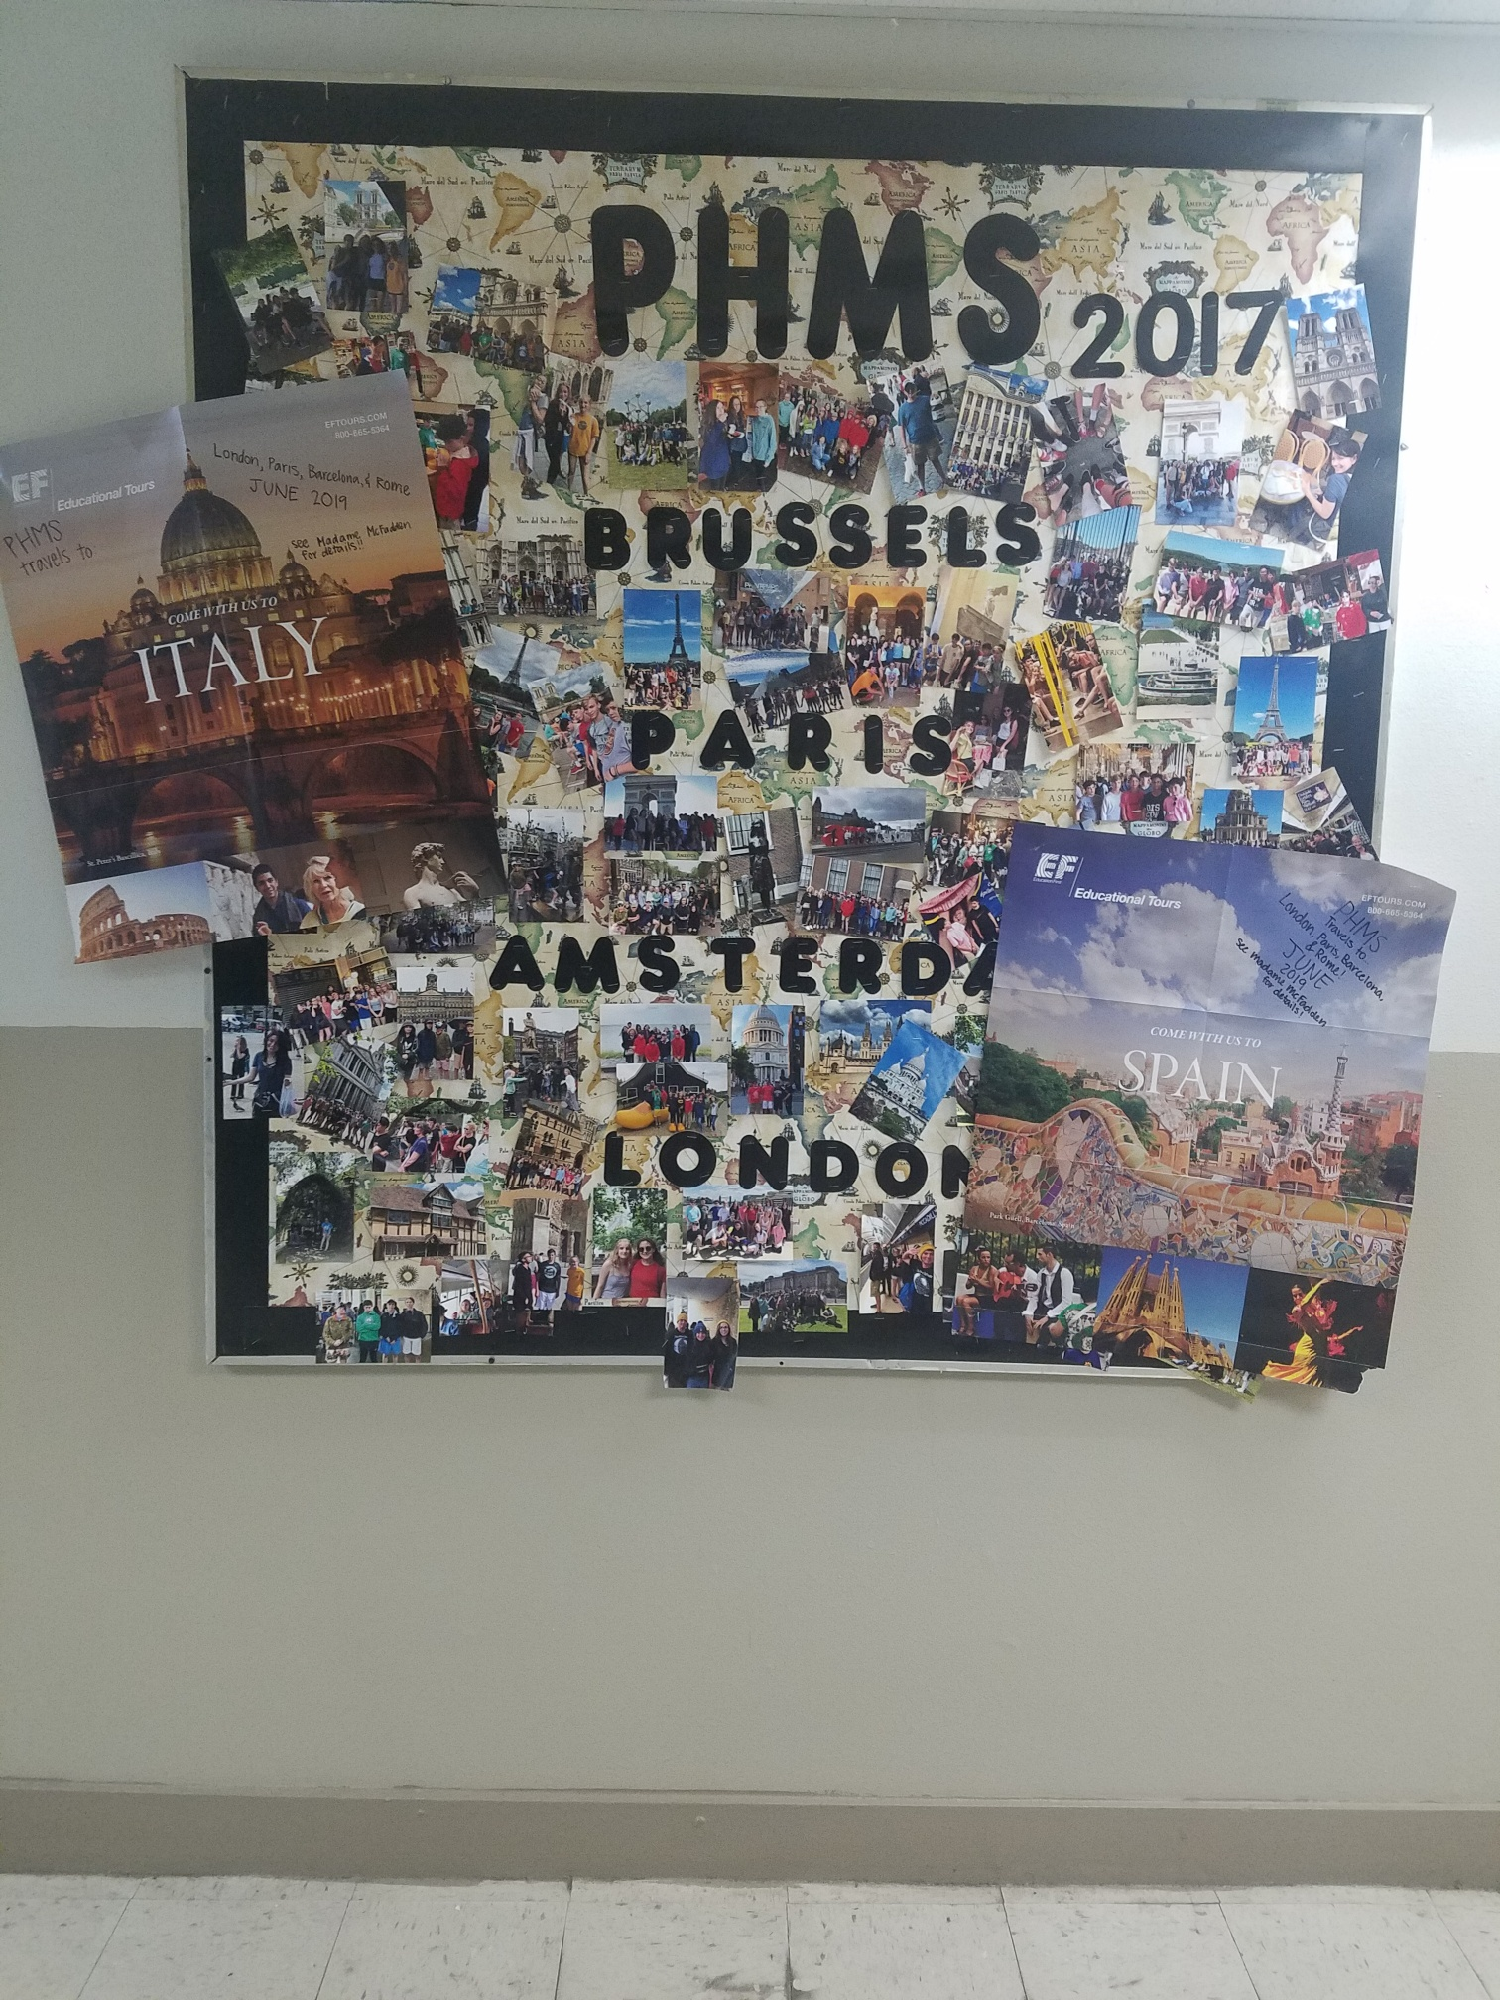
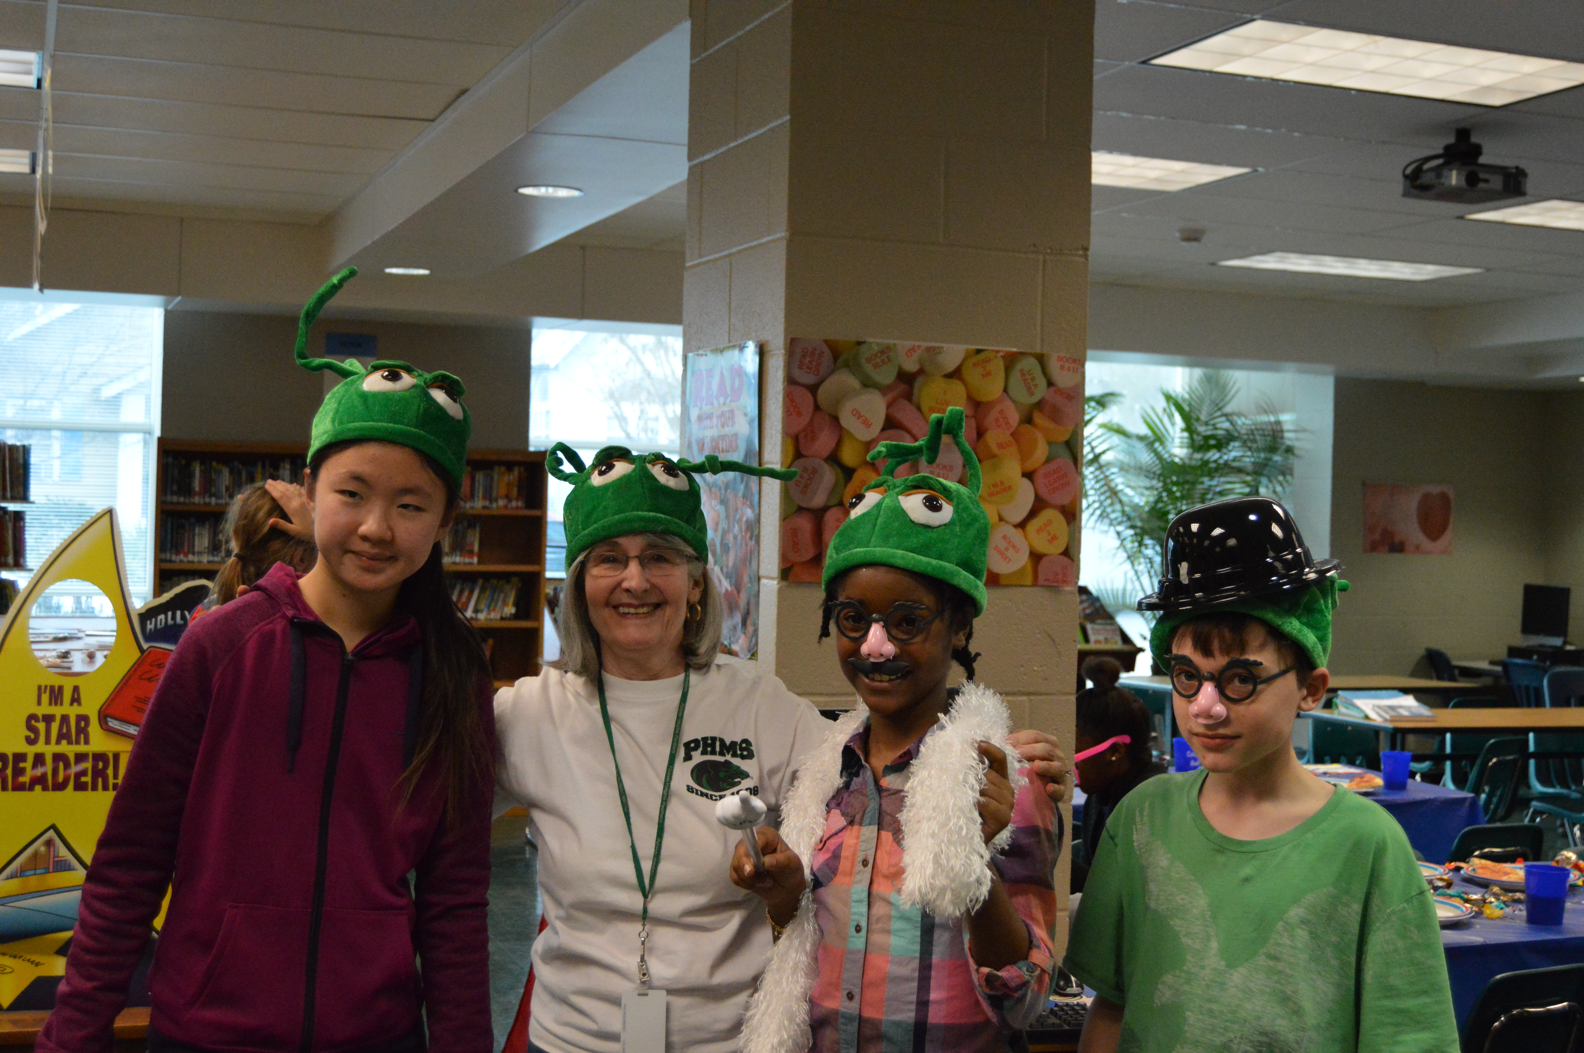
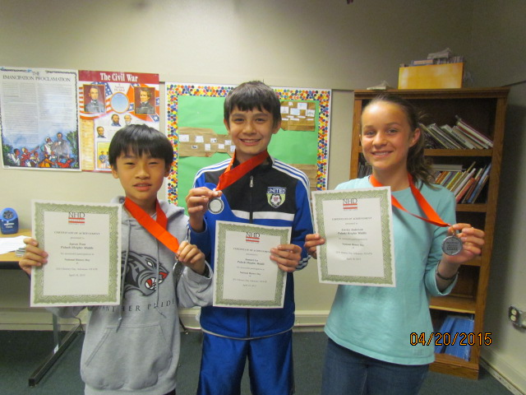
Celebrations
Annual Foreign Language Trips
France, Spain, England, Italy, Switzerland, Greece, Morocco, Costa Rica, and Dominican Republic
PBL- In coordination with Central Arkansas Water, PHMS science and EAST student will participate in real-life project based learning activities.
Quiz Bowl Team
Attended the Nationals in New Orleans for the past 8 years.
National History Day
Won 1st and 2nd in state competitions and some students attend the national competition in Maryland.
EAST
Consistently rated as a superior program at the annual EAST Partnership conference.

Slide 10
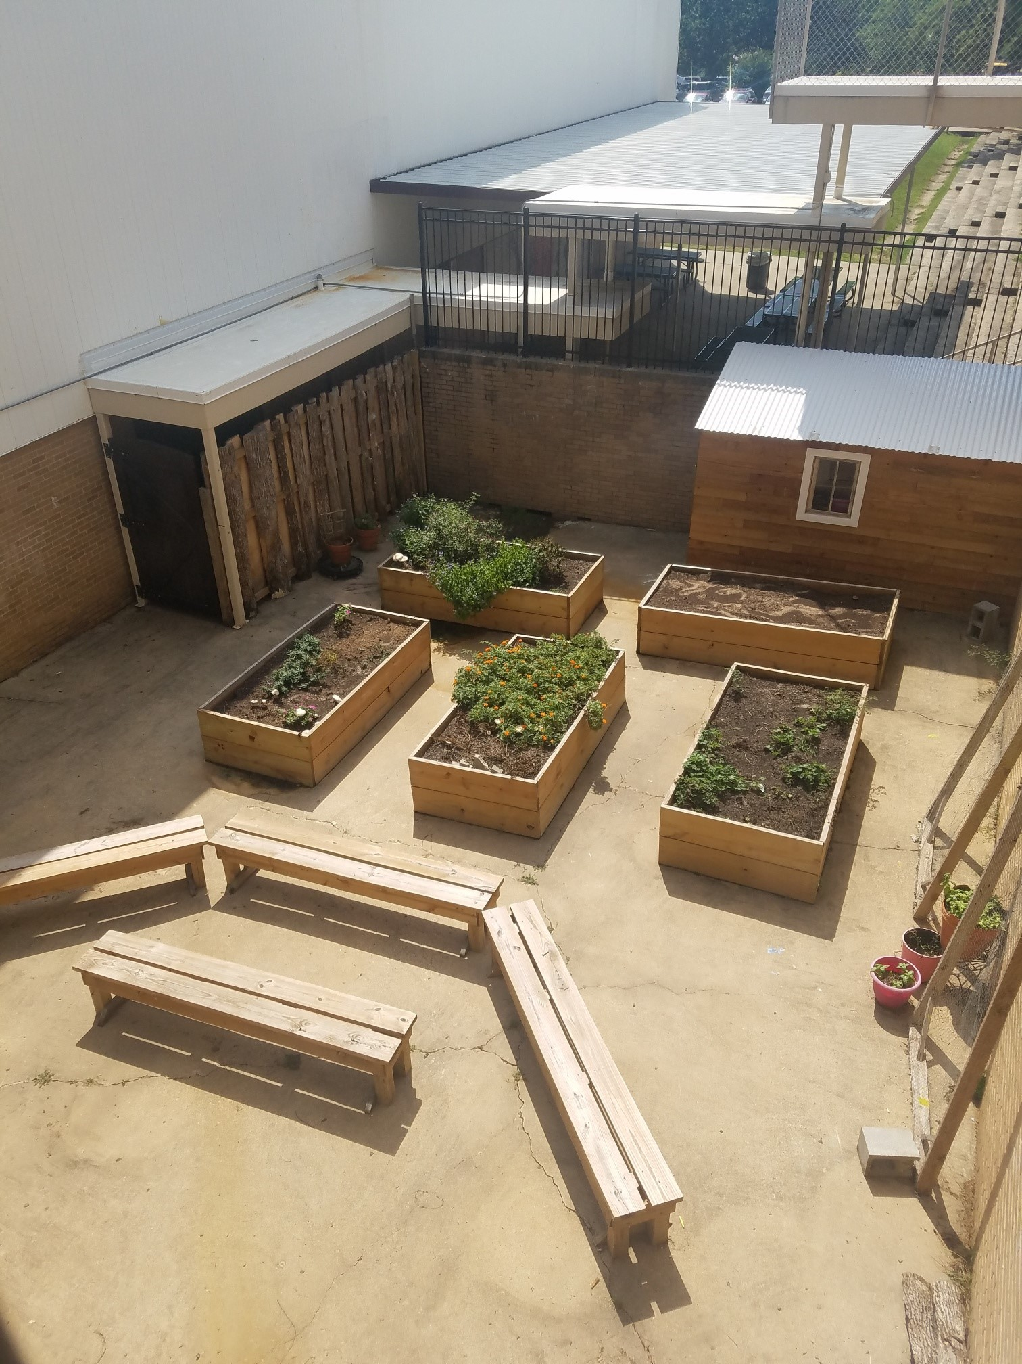
Celebrations
Duke Talent Identification Program
54 students qualify for the Duke TIP program
National Junior Honor Society
81 students recognized in the National Junior Honor Society in 2017.
VIP Awards
Awards for the Most Volunteer Hours for Middle School
PHMS has a Science Bowl team, participates in Future Business Leaders of America, and has received numerous awards for Math Counts.
Planet Earth classes use an outdoor classroom designed by students.

Slide 11
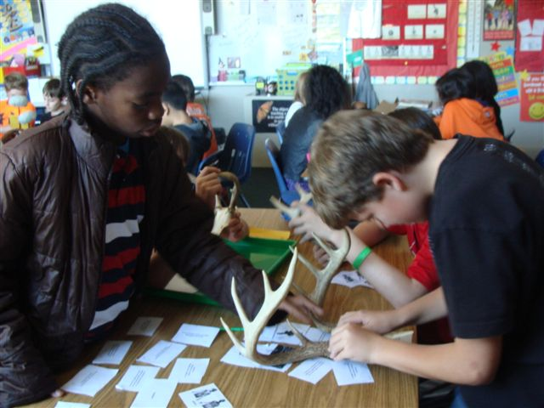
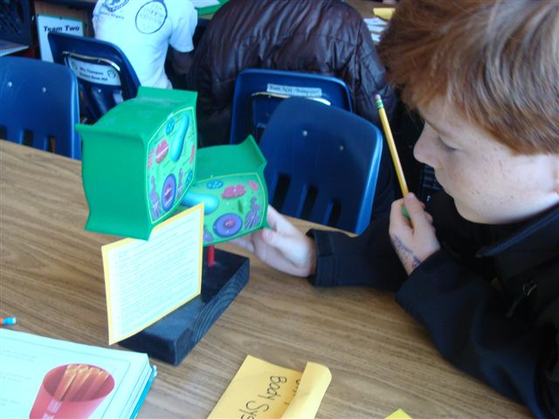
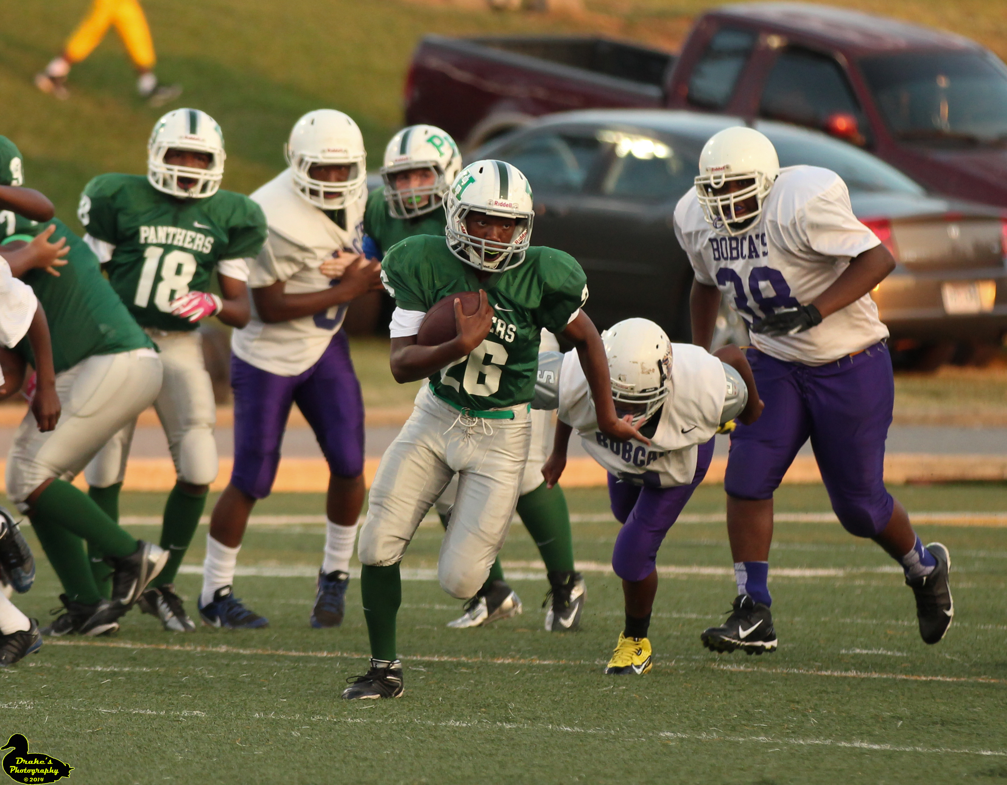
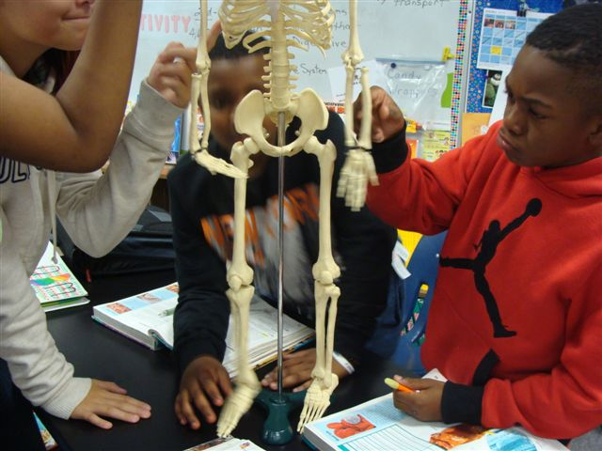
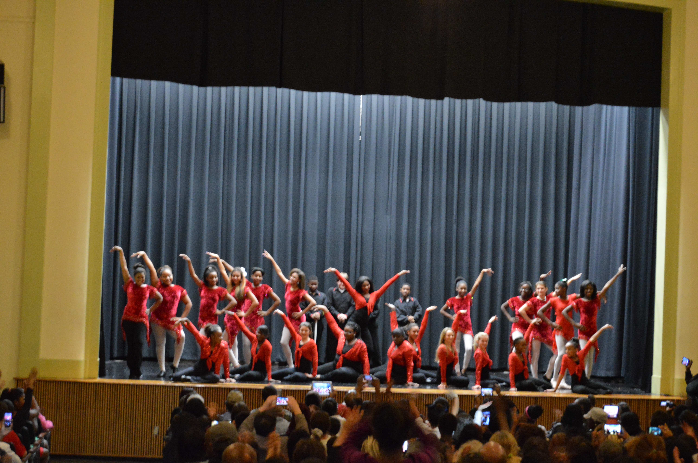
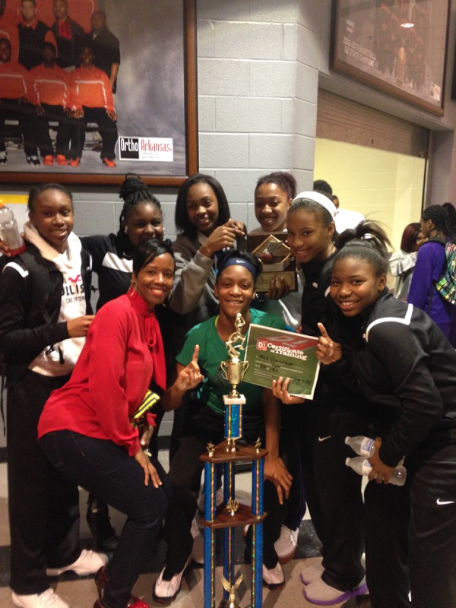
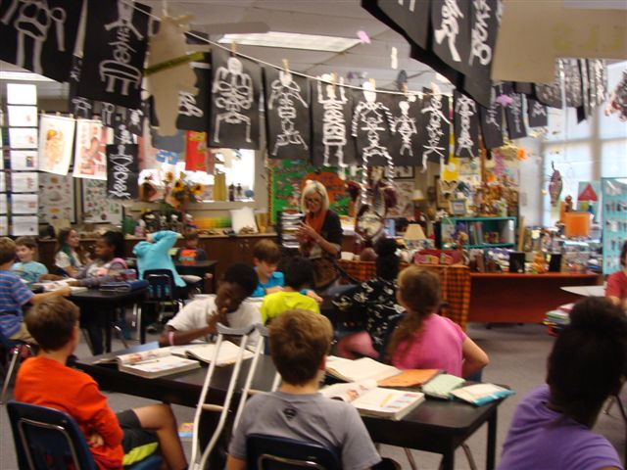
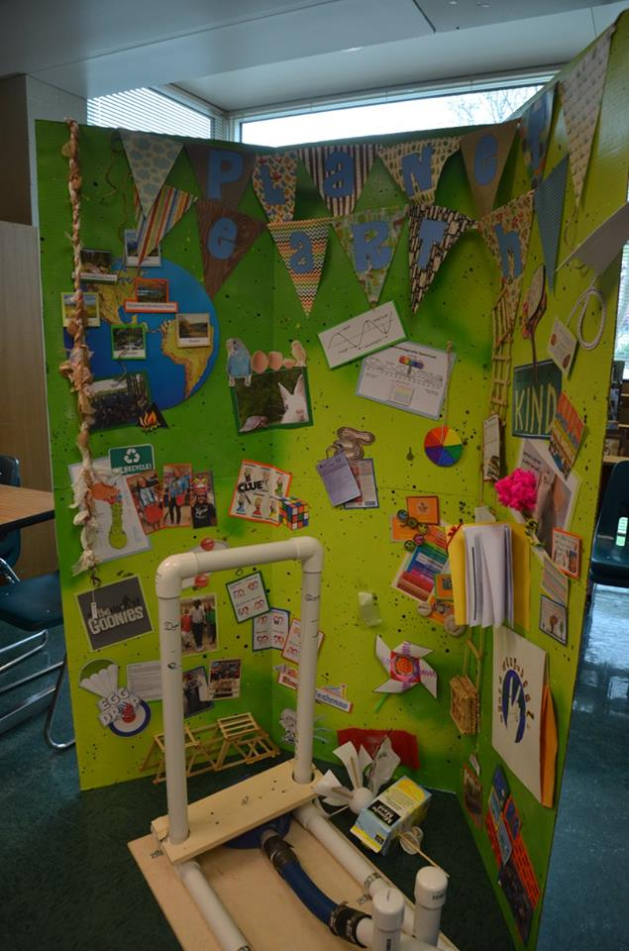
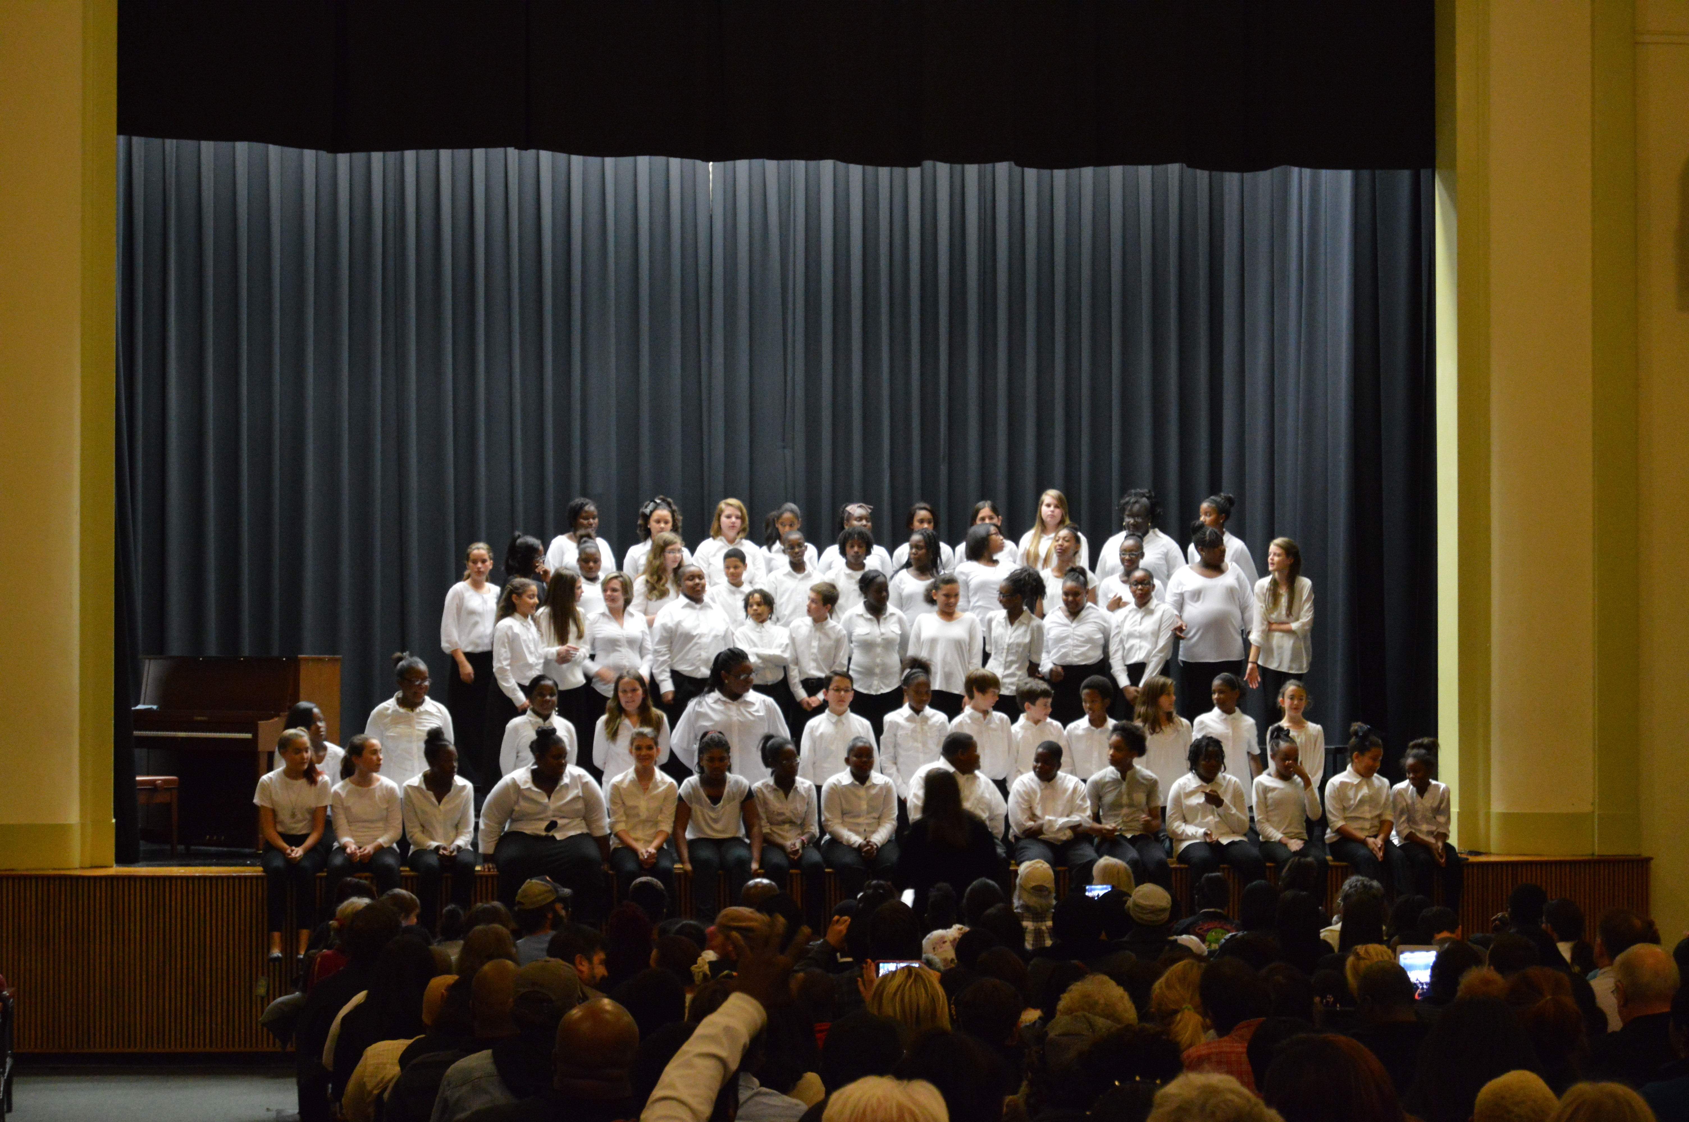
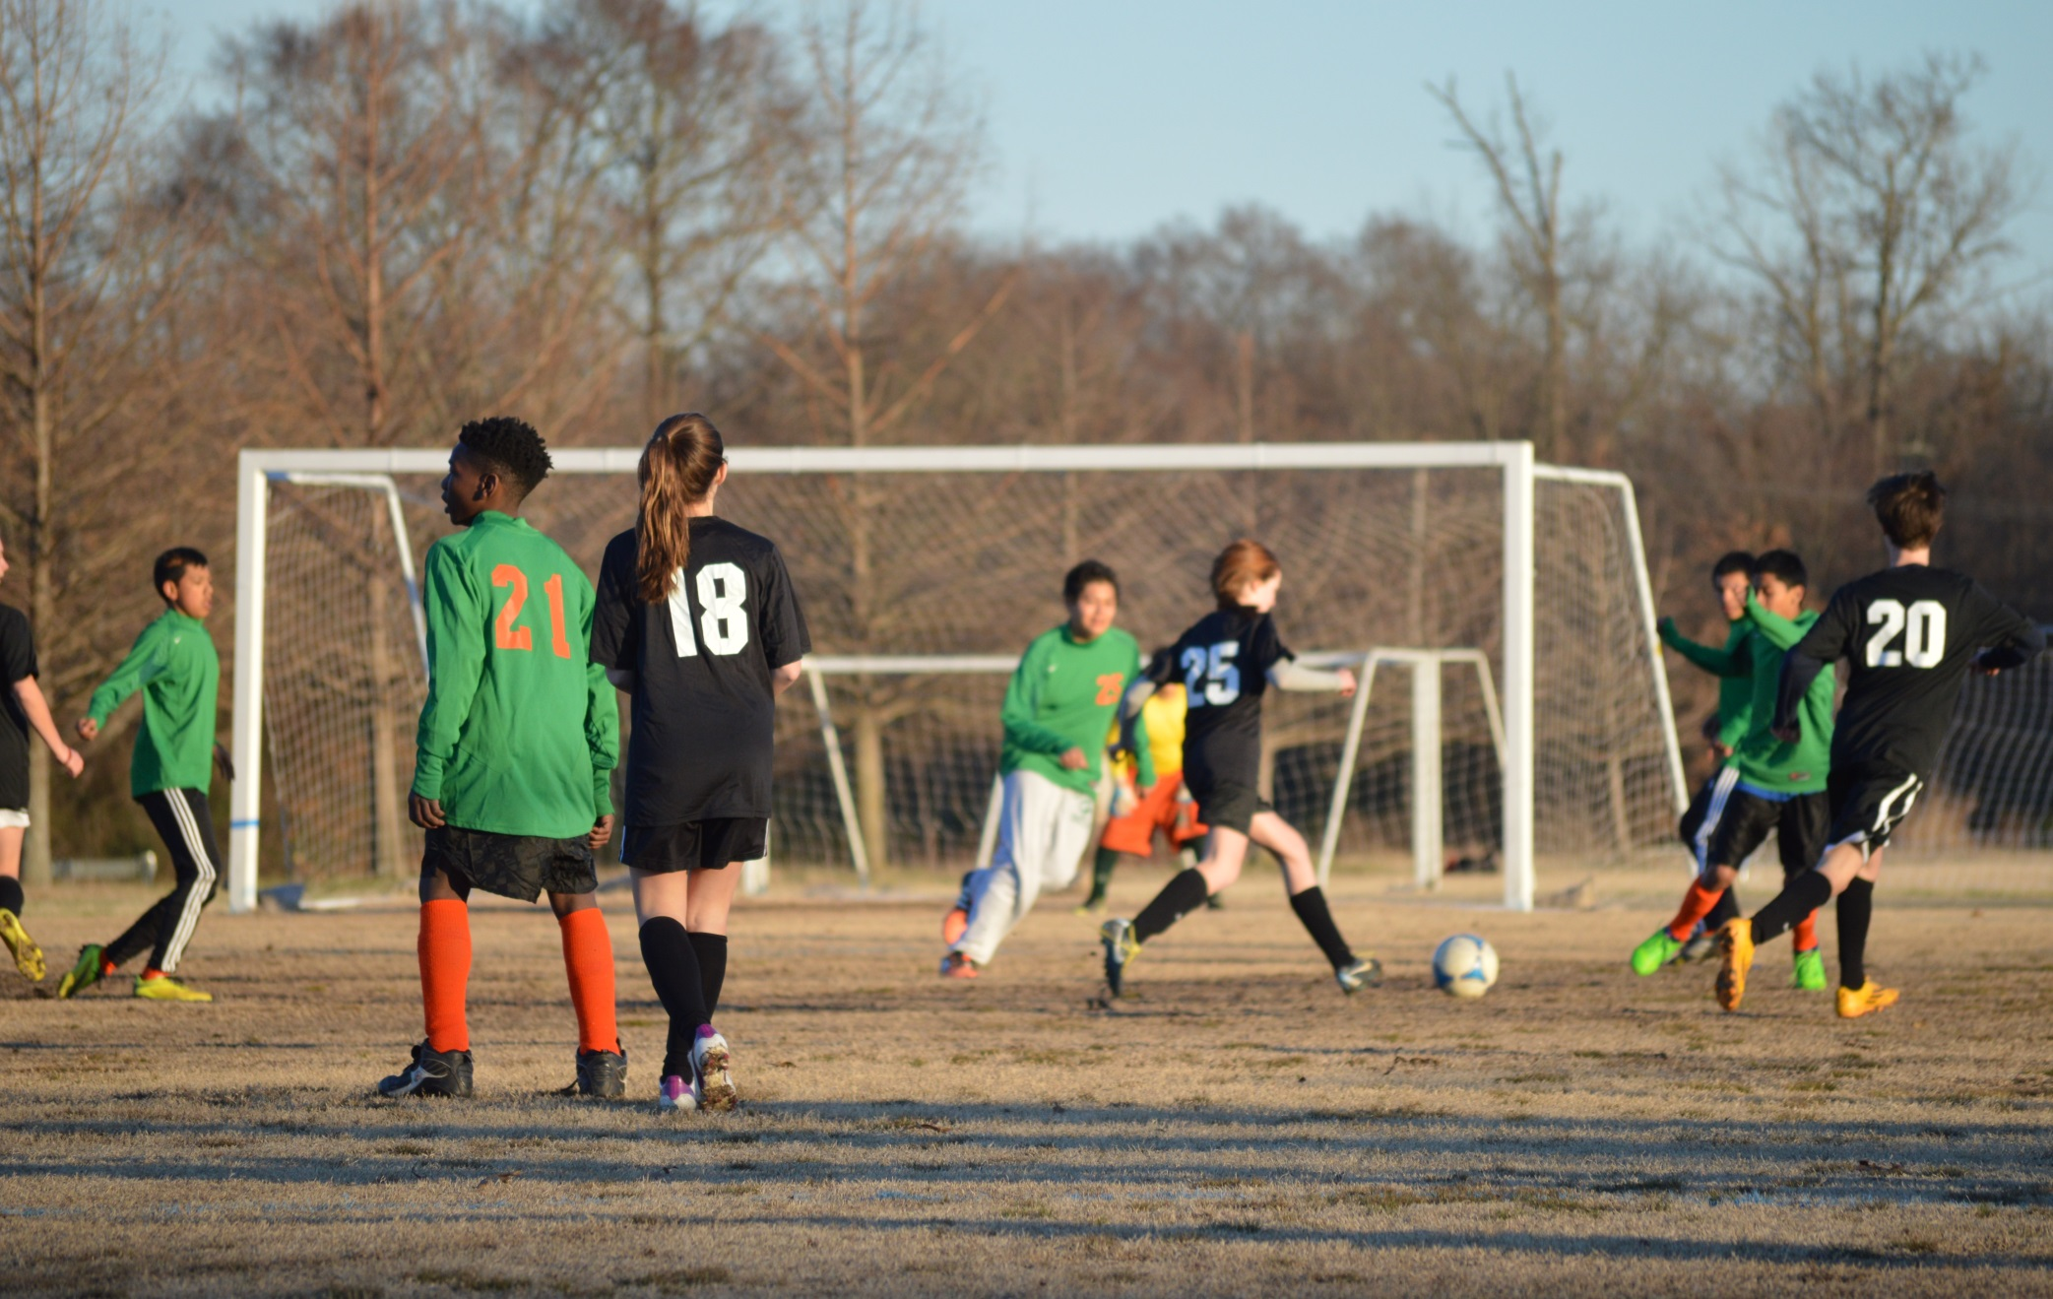
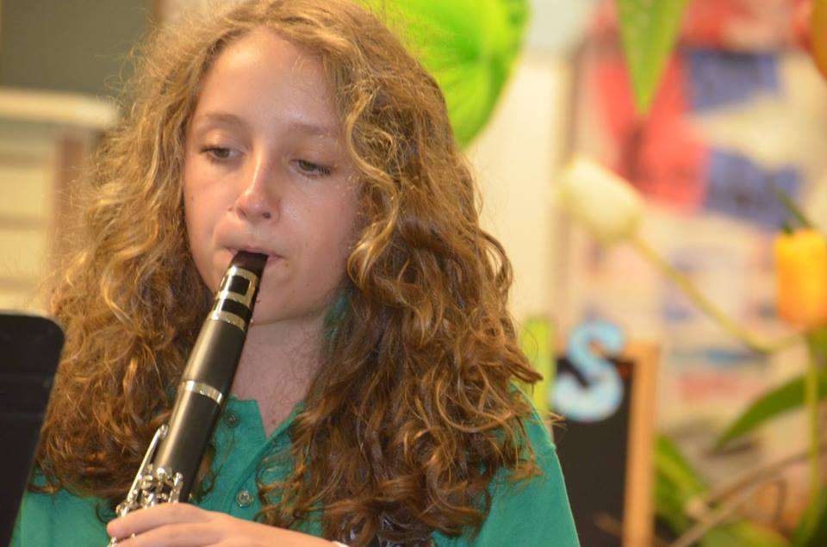
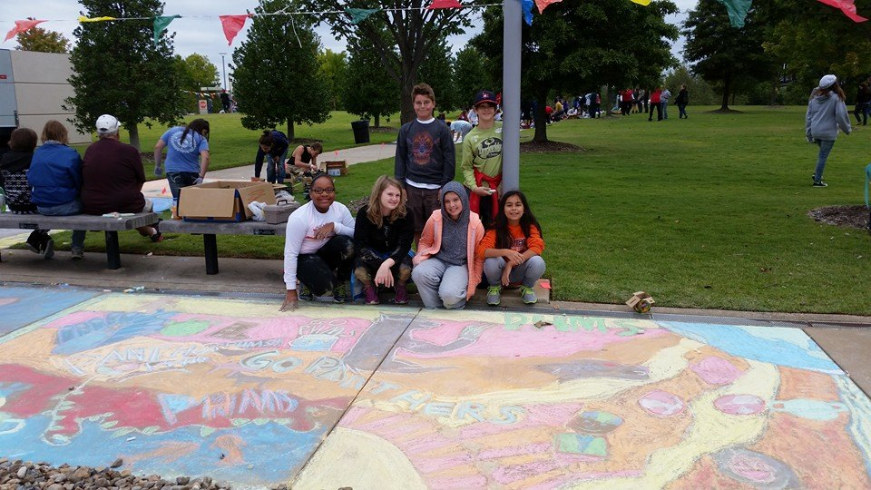
Pulaski Heights Family Is A Community Where Students Are Our Number One Priority

